Slide 1
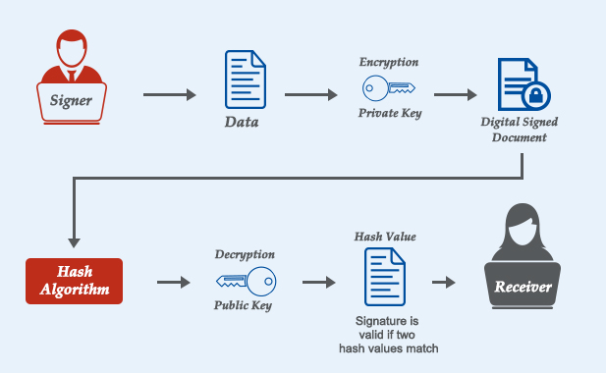
BCSE309L - Cryptography and Network Security
Module 5 - RSA based Digital Signature

Slide 2
Digital Signatures Schemes
Digital Signature Standard (DSS)
ElGamal Digital Signature Scheme - “Taher AlGamal (1985)”
RSA Digital Signature
Schnorr Digital Signature Scheme - “Claus Peter Schnorr (1991-2008)”

Slide 3
RSA Digital Signature
RSA digital signatures use the RSA public-key cryptosystem to verify the authenticity and integrity of a message
It involves three key steps:
Key generation
Signing
Verification

Slide 4
How RSA Digital Signatures Work
Key Generation:
Generate two keys: a private key and a public key
The private key is kept secret and used for signing
The public key is shared and used for verification
Signing Process:
A hash function (e.g., SHA-256) is applied to the message to create a fixed-length message digest
The message digest is encrypted using the sender’s private key via RSA encryption, creating the digital signature
The signature is sent along with the original message

Slide 5
Cont…
Verification Process:
The receiver decrypts the signature using the sender’s public key, obtaining the original message digest
The receiver independently hashes the received message using the same hash function
If the computed hash matches the decrypted hash, the signature is valid, proving message integrity and authenticity

Slide 6
Mathematical Representation
Key Generation:
Select two large prime numbers p and q
Compute n=p×q (modulus)
Compute ϕ(n)=(p−1)(q−1)
Choose public exponent e (typically 65537)
Compute private exponent d, where d is the modular inverse of e modulo ϕ(n)

Slide 7
Cont…
Signing:
Compute the hash H(m) of message m
Compute the signature: S = H(m)^{d} mod n
Verification:
Decrypt signature: H(m)′ = S^{e} mod n
Compute hash H(m) of the received message
If H(m)=H(m)′, the signature is valid

Slide 8
Security Considerations
Hash function: Must be secure (e.g., SHA-256) to prevent collisions
Key size: At least 2048-bit RSA keys are recommended for strong security
Padding schemes: RSA signatures should use padding schemes like PKCS#1 v1.5 or PSS (Probabilistic Signature Scheme) to enhance security

Slide 9
Example
Alice wants to digitally sign a message using the RSA algorithm. She chooses the prime numbers: p=47, q=59
She selects the public exponent e=13.
(a) Compute the public key (e,n) and private key d. (b) Sign the message M=89 by computing the digital signature S. (c) Verify the signature by computing S^{e}mod n.

Slide 10
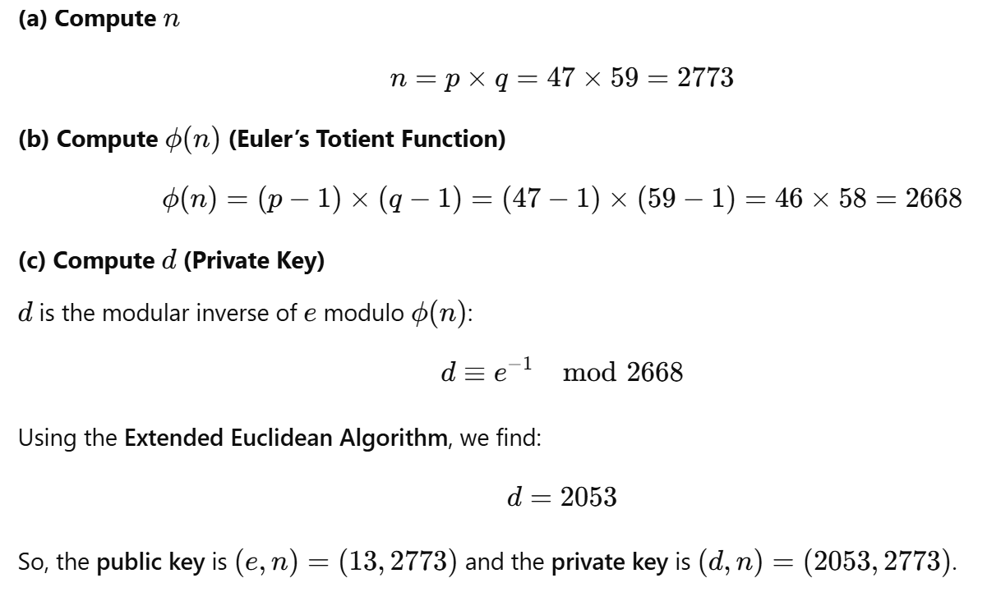
Solution

Slide 11
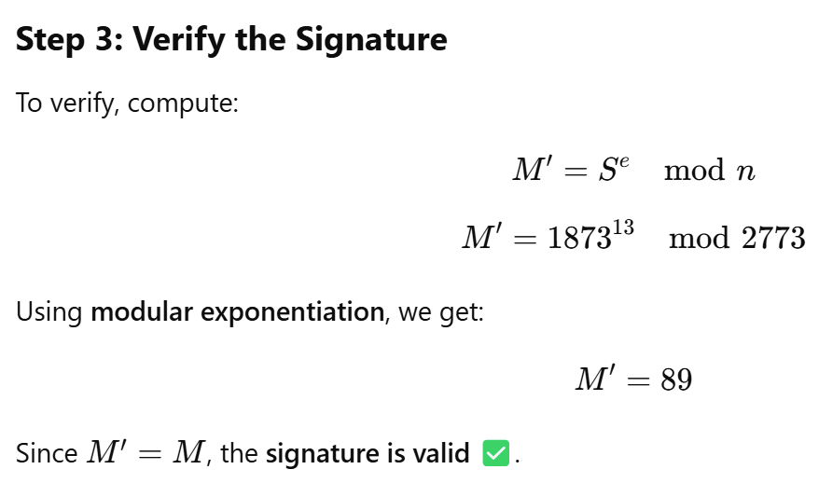
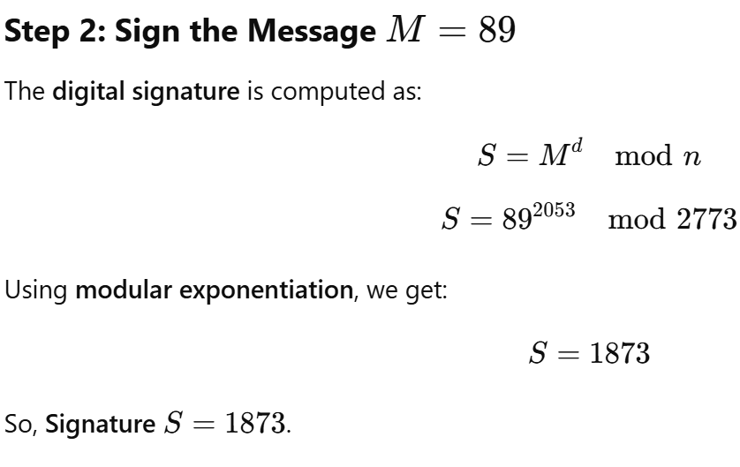
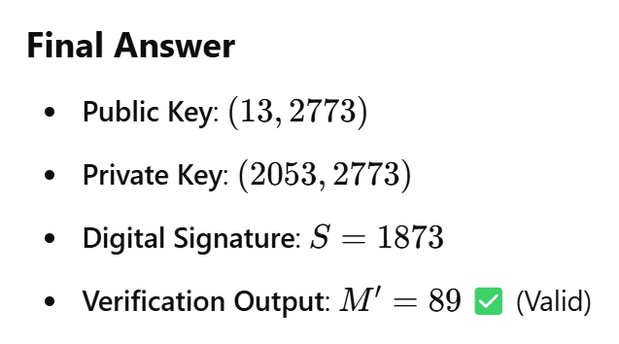
Cont…

Slide 12
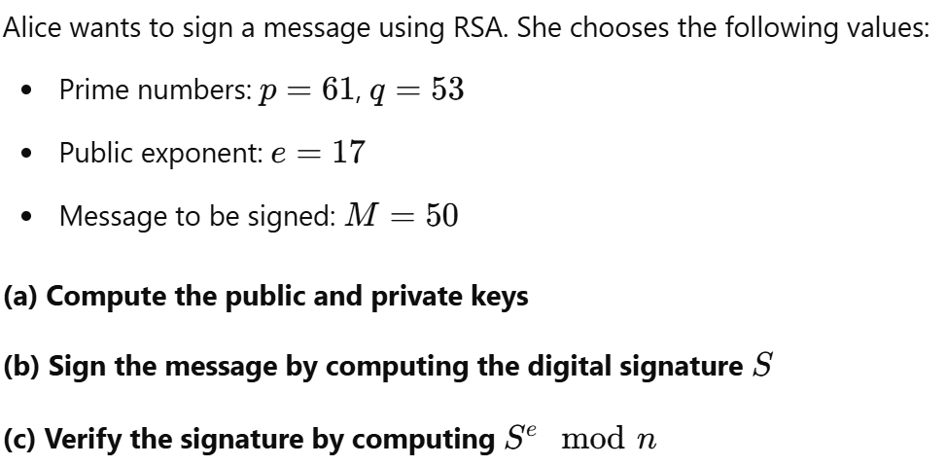
Exercise

Slide 13
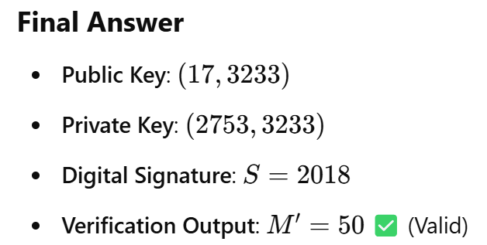
Solution - Exercise

